Slide 1
Typescript
Version: 2.6.2
Monica Pandey • 20.12.2017

Slide 2
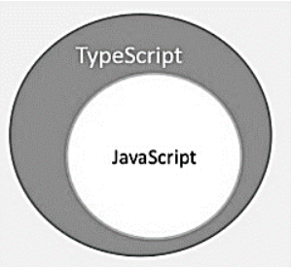
Introduction
Definition
Typescript is javascript for application-scale development.
It is superset of javascript compiled to javascript.
It is designed by Anders Hejlsberg

Slide 3
Typescript is just javascript
Typescript supports other JS libraries
Javascript is typescript
.js <-> .ts
Features
Typescript is portable
Typescript = Javascript + some additional features

Slide 4
Why Typescript?
Compilation
Javascript is an interpreter whereas Typescript transpiler provides error-checking mechanism
Strong static typing
Typescript comes with type inference through TLS
Type Definition
Typescript Definition file (.d.ts) provides definition for external Javascript libraries

Slide 5
Why Typescript? (Cont...)
Supports OOPs
Supports object oriented programming eg. classes, objects, inheritance etc

Slide 6
Environment Setup
Node.js
Install node.js via https://nodejs.org/en/
IDE
Install supported IDEs like Visual Studio Code, Brackets
Typescript
Install typescript
sudo npm install typescript -g

Slide 7
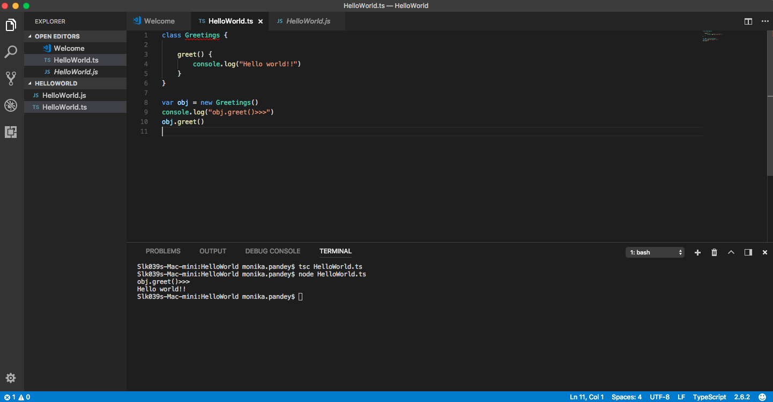
HelloWorld.ts

Slide 8
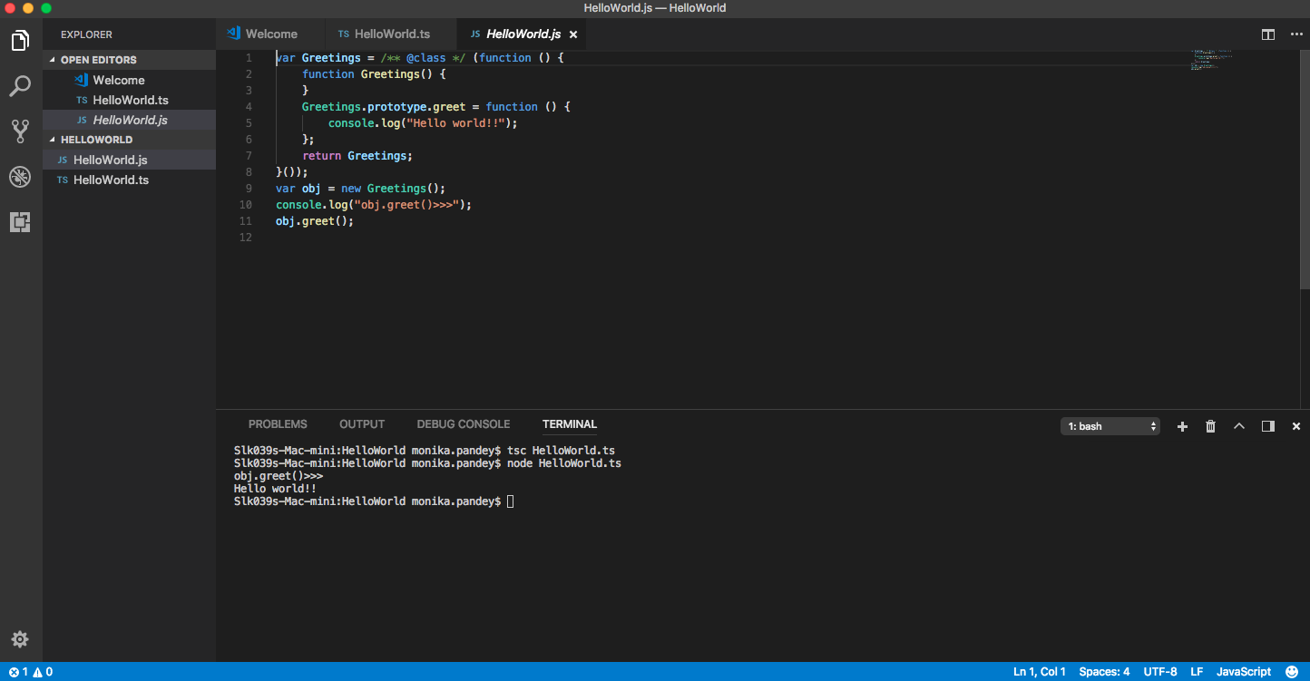
HelloWorld.js

Slide 9
Run & Compile
Compile
tsc HelloWorld.ts
Run
node HelloWorld.js

Slide 10
Identifiers: Rules
Identifiers are names given to elements in a program like variable, functions etc
Can include both characters & digits.
Can't begin with digit.
Can't include special characters except underscore(_) & dollar($) sign.
Can't be a keyword. Must be unique.
Case-sensitive.
Can't contain spaces.

Slide 11
Line of code
Semicolons are optional
Comments
Single line - //
Multiline - /* * */

Slide 12
Datatypes
Any
*The supertype of all data types
Built-in types
*number, string, boolean, void, null, undefined
User-defined types
*arrays, enums, classes, interfaces

Slide 13
Null & Undefined
Undefined
A variable initialized with undefined means that the variable has no value.
Or the object assigned to it has no value
Null
Variable has been assigned an object which has value undefined

Slide 14
Variable
Declarations:
var [identifier] : [type-annotation] = value ; // var name: string = "marry" ;
var [identifier] : [type-annotation] ; //var name: string ;
var [identifier] = value ; // var name = "marry" ;
var [identifier] ; // var name: string ;

Slide 15
Strong Type & Type Inference
var name:string = "John"; var score1 = 50; score1 = "Doe" //error

Slide 16
Type Assertion
Change variable type
Symbol: <S> <T> *S, T are data types
S should be supertype of T or vice-versa
Eg:
var str = '1' var str2 = <number> <any> str console.log(str2) // 1
console.log(typeOf(str2)) // string

Slide 17
Variable Scope
Global
Local
Class
Static
var global_num = 12 //global variable class Numbers { num_val = 13; //class variable static sval = 10; //static field storeNum():void { var local_num = 14; //local variable } }

Slide 18
Decision Making
Supported decision making statements are:
If statements
If...else statements
Nested if... else statements
Switch statements

Slide 19
Loops
Supported loops are:
for loop
while loop
do...while loops
break
continue

Slide 20
Functions
Types of functions are:
Non-void returning functions
Parameterized functions
Optional parameterized functions
Rest parameterized functions
Default parameterized functions
Anonymous functions
Lambda functions
Syntactic functions

Slide 21
Optional Parameters
Usage
When passing argument is not compulsory
Parameter can be marked as optional by ? mark
Optional parameter should be declared last in argument body

Slide 22
Optional Parameters (Cont…)
Function details(id:number,name:string,mail_id?:string) { console.log("ID:", id); console.log("Name",name); if(mail_id!=undefined) console.log("Email Id",mail_id); } details(123,"John"); details(111,"mary","mary@xyz.com");

Slide 23
Rest Parameters
Usage
No restriction in number of arguments to be passed in a function
It acts as placeholder for multiple arguments

Slide 24
Rest Parameters (Cont…)
function buildName(firstName: string, ...restOfNames) { return firstName + " " + restOfNames.join(",") }
let employeeName = buildName("Joseph", "Samuel", 1, "MacKinzie");
console.log("Employee Name: ", employeeName);
//Joseph Samuel, 1, MacKinzie

Slide 25
Default Parameters
Usage
Function parameters can also be given a value by default
Explicit values could be passed to such arguments
function calculate_discount(price:number,rate:number = 0.50) { var discount = price * rate; console.log("Discount Amount: ",discount); } calculate_discount(1000) calculate_discount(1000,0.30)

Slide 26
Anonymous Function
Usage
Identifier less function
Can accept input and return outputs
Not accessible after its creation
Can be assigned to a variable known as function expression
var res = function(a:number,b:number) { return a*b; }; console.log(res(12,2))

Slide 27
Lambda Function
Usage
Another type of anonymous function
Also known as arrow function (=>)
Single letter parameter should be used for convention
var foo = (x:number)=>10 + x console.log(foo(100)) // 110
var foo = (x:number)=> { x = 10 + x console.log(x) } foo(100)

Slide 28
Syntactic Function
Usage
Data type of parameter is not needed to be defined
Data type considered is ‘any’
var func = (x)=> { if(typeof x=="number") { console.log(x+" is numeric") } else if(typeof x=="string") { console.log(x+" is a string") } } func(12) func("Tom")

Slide 29
Tuples
Usage
A heterogeneous collection of values
Values of varied types could be stored
Could be passed as an argument to a function
var mytuple = [10,"Hello"]; //create a tuple console.log(mytuple[0]) console.log(mytuple[1])

Slide 30
Tuples Operations
length
push()
pop()
var mytuple = [10,"Hello","World","typeScript"]; console.log("Items before push "+mytuple.length) // 4
mytuple.push(12) // append value to the tuple console.log("Items after push "+mytuple.length) // 5
console.log(mytuple.pop()+" popped from the tuple") // 12 popped from the tuple console.log("Items after pop "+mytuple.length) // 4

Slide 31
Updating Tuples
Tuples are mutable collection types
var mytuple = [10,"Hello","World","typeScript"]; //create a tuple console.log("Tuple value at index 0 is "+mytuple[0]) //Tuple value at index 0 is 10 //update a tuple element mytuple[0] = 121 console.log("Tuple value at index 0 changed to "+mytuple[0]) //Tuple value at index 0 changed to 121

Slide 32
Destructuring Tuples
USage
Breaking down of tuples
var a =[10,"hello"] var [b,c] = a console.log( b ) // 10 console.log( c ) // hello

Slide 33
Union
Usage
Combining multiple types with the use of pipe( | )
A variable can be of type union
A union can be passed as function argument as well
var val:string|number val = 12 console.log("numeric value of val "+val) val = "This is a string" console.log("string value of val "+val)
//Output:
numeric value of val 12 string value of val This is a string

Slide 34
Union(Cont…)
Union type as function parameter
function disp(name:string|string[]) { if(typeof name == "string") { console.log(name) } else { var i; for(i = 0;i<name.length;i++) { console.log(name[i]) } } } disp("mark") console.log("Printing names array....") disp(["Mark","Tom","Mary","John"])

Slide 35
Interface
Usage
Interface just defines syntax of an entity
If any entity confirms to an interface, it has to adhere to the interface's syntax
It's a feature of typescript so it's not converted to javascript

Slide 36
Interface(Cont…)
Interface.ts
interface IPerson { firstName:string, lastName:string, sayHi: ()=>string } var customer:IPerson = { firstName:"Tom", lastName:"Hanks", sayHi: ():string =>{return "Hi there"} } console.log("Customer Object ") console.log(customer.firstName) console.log(customer.lastName) console.log(customer.sayHi())

Slide 37
Interface(Cont…)
Interface.js
var customer = { firstName:"Tom", lastName:"Hanks", sayHi: ():string =>{return "Hi there"} }
console.log("Customer Object ") console.log(customer.firstName) console.log(customer.lastName) console.log(customer.sayHi())

Slide 38
Interface & Inheritance
interface Person { age:number } interface Musician extends Person { instrument:string } var drummer = <Musician>{}; drummer.age = 27 drummer.instrument = "Drums" console.log("Age: "+drummer.age) //Age: 27
console.log("Instrument: "+drummer.instrument)//Instrument: Drums

Slide 39
Multiple Interface Inheritance
interface IParent1 { v1:number } interface IParent2 { v2:number } interface Child extends IParent1, IParent2 { } var Iobj:Child = { v1:12, v2:23} console.log("value 1: "+Iobj.v1+" value 2: "+Iobj.v2)
//Value1: 12 value 2: 23

Slide 40
Classes
Usage
Classes encapsulates the data
Classes are the foundation OOPs
Typescript supports classes
Javascript doesn't support classes
A class has a field, constructor & functions

Slide 41
Classes(Cont…)
.ts
class Person { }
.js
var Person = /**@class**/(function () { function Person() { } return Person; }());

Slide 42
Classes(Cont…)
Declaring class
class Car { //field engine:string; //constructor constructor(engine:string) { this.engine = engine } //function disp():void { console.log("Engine is : "+this.engine) } }

Slide 43
Classes(Cont…)
Creating instance objects
var obj = new Car("Engine 1")
Accessing attributes & functions
var obj = new Car("XXSY1") //access the field console.log("Reading attribute value Engine as : "+obj.engine) //access the function obj.disp()

Slide 44
Class Inheritance(Cont…)
Usage
Deriving a new class from an existing class
class Shape { Area:number constructor(a:number) { this.Area = a } } class Circle extends Shape { disp():void { console.log("Area of the circle: "+this.Area) } } var obj = new Circle(223); obj.disp() // Area of the Circle: 223

Slide 45
Types of inheritance
Single : Supported
Multiple: Not Supported
Multi-level: Supported. See the following example
class Root { str:string; } class Child extends Root {} class Leaf extends Child {} //indirectly inherits from Root by virtue of inheritance var obj = new Leaf(); obj.str ="hello" console.log(obj.str) // hello

Slide 46
Classes with Interface
interface ILoan { interest:number } class AgriLoan implements ILoan { interest:number rebate:number constructor(interest:number,rebate:number) { this.interest = interest this.rebate = rebate } } var obj = new AgriLoan(10,1) console.log("Interest is : "+obj.interest+" Rebate is : "+obj.rebate ) //Interest is : 10 Rebate is : 1

Slide 47
Access Specifiers
Public
Universal accessibility
Private
Accessible only within the class
Protected
Accessible within same class and child classes only

Slide 48
Namespaces
Usage
Grouping of logically related code
To avoid overwriting of global declarations
namespace SomeNameSpaceName { export interface ISomeInterfaceName { } export class SomeClassName { } }
Classes or interfaces to be used outside namespaces has to be declared with export keyword
SomeNameSpaceName.SomeClassName;
To refer namespace from different file
/// <reference path = "SomeFileName.ts" />

Slide 49
Namespaces(Cont…)
Nested namespace
FileName : Invoice.ts namespace tutorialPoint { export namespace invoiceApp { export class Invoice { public calculateDiscount(price: number) { return price * .40; } } } } FileName: InvoiceTest.ts /// <reference path = "Invoice.ts" /> var invoice = new tutorialPoint.invoiceApp.Invoice(); console.log(invoice.calculateDiscount(500));

Slide 50
Module
Internal module
Internal module = namespace
External module
To load multiple third party js libraries
Each file is considered as a separate module
To compile in commonJS -
tsc --module commonjs TestShape.ts
To compile in AMD -
tsc --module amd TestShape.ts

Slide 51
Thank you

